Slide 1

MOHAN LAL SUKADIA UNIVERSITY, UDAIPUR
University College Of Science, MLSU
Bachelor Of Computer Applications
MAJOR PROJECT
ON
“PLAYVERSE”
SUBMITTED TO :
SUBMITTED BY:
Dr. Avinash Panwar
RAJAT KHANUJA

Slide 2
Platform Objectives
Provide a Seamless Gaming Experience: Ensure that users can easily browse, purchase, and download PC games with minimal friction.
Offer a Diverse Game Library: Curate a vast collection of games across various genres, including indie, AAA, and exclusive titles.
Ensure Secure Transactions: Integrate secure payment gateways to protect user data and provide safe, hassle-free purchases.
Promote Game Discovery: Use personalized recommendations and filtering options to help users find games based on preferences.
Enhance User Engagement: Implement features such as reviews, ratings, wishlists, and game recommendations to keep users engaged.
Optimize Performance: Ensure the platform is fast, responsive, and performs well on various devices, including desktops, tablets, and mobile devices.

Slide 3
Table of Content
Overview
Product Introduction
Hardware and software specification requirements
Product Modules
Future scope of the product
Conclusion
References

Slide 4
Overview
PlayVerse is an online platform designed to offer a seamless experience for purchasing and discovering PC games. Built using the MERN stack (MongoDB, Express.js, React.js, Node.js), the website provides users with access to a diverse catalog of games across various genres, from indie to AAA titles. The platform allows users to browse, search, filter, and purchase games securely through integrated payment gateways
PlayVerse is designed with scalability in mind, allowing future enhancements and features to be integrated easily. The project demonstrates a comprehensive use of modern web technologies and serves as a final capstone for demonstrating proficiency in full-stack development.

Slide 5
Product Introduction
Playverse is an innovative online platform that allows users to explore, purchase, and enjoy a wide range of PC games in one centralized hub. Designed to cater to both casual gamers and dedicated enthusiasts, Playverse offers a diverse library of gaming titles spanning multiple genres, from indie gems to blockbuster AAA releases.
1. Comprehensive Game Marketplace: Playverse offers a vast library of PC games, catering to all genres and preferences, from indie titles to major AAA releases.
2. User-Friendly Interface: The platform provides a simple and intuitive browsing experience, allowing users to easily search, filter, and discover games.
3. Secure Transactions: Integrated payment gateways ensure safe and hassle-free purchases, protecting user data with secure authentication methods.
4. Personalized Features: Users can create wishlists, receive tailored game recommendations, and read community reviews to make informed choices.
5. Scalable and Future-Ready: Built using the MERN stack, Playverse is designed for future enhancements and can scale to accommodate growing user demand and features.

Slide 6
Hardware and software specification requirements
HARDWARE SPECIFICATION
Specifications | System
BRAND | HP VICTUS 16
PROCESSOR | AMD RYZEN 5 HEXA CORE 5600 H
OPERATING SYSTEM | WINDOWS
WINDOW VERSION | W-11
RAM | 8 GB
ROM | 512 GB
GRAPHICS | AMD RX550m 4GB GRAPHICS CARD

Slide 7
SOFTWARE SPECIFICATION
1. Front-End Technology:
- React.js: Used for building a responsive and interactive user interface, allowing seamless browsing and dynamic content loading.
2. Back-End Technology:
- Node.js & Express.js: Backend server responsible for handling API requests, managing user data, and connecting to the database.
3. Database:
- MongoDB: NoSQL database used for storing user information, game data, purchase history, and other records in a flexible document format.
4. Authentication:
- JWT (JSON Web Tokens): Provides secure user authentication and authorization for login and registration processes.
5. Development Tools:
- Visual Studio Code: IDE used for writing, debugging, and managing the codebase.
- Postman: Used for testing API endpoints.
- Jest/Mocha: Used for unit testing to ensure functionality and bug-free code.
These specifications highlight the technologies and tools that power Playverse, ensuring a secure, scalable, and user-friendly gaming platform.

Slide 8
SNAPSHOTS

Slide 9
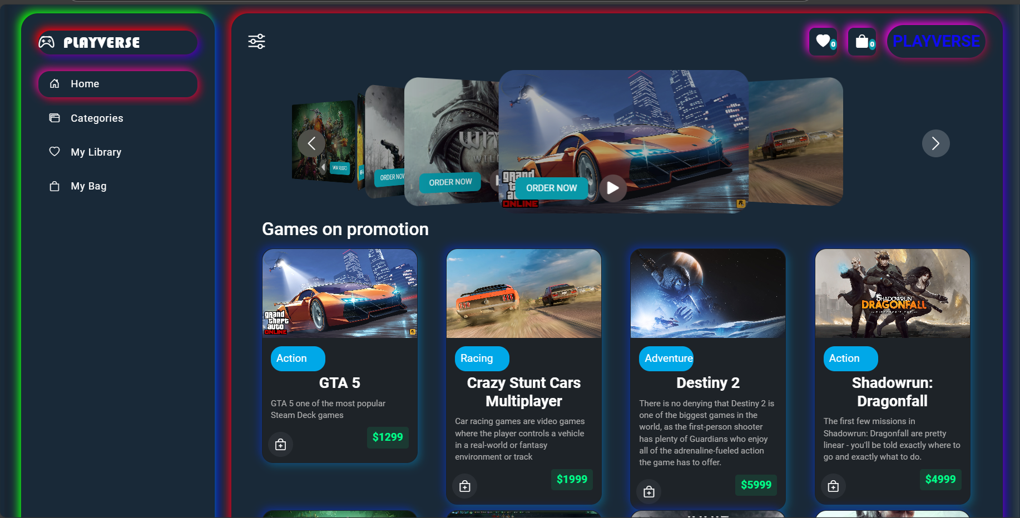

Slide 10
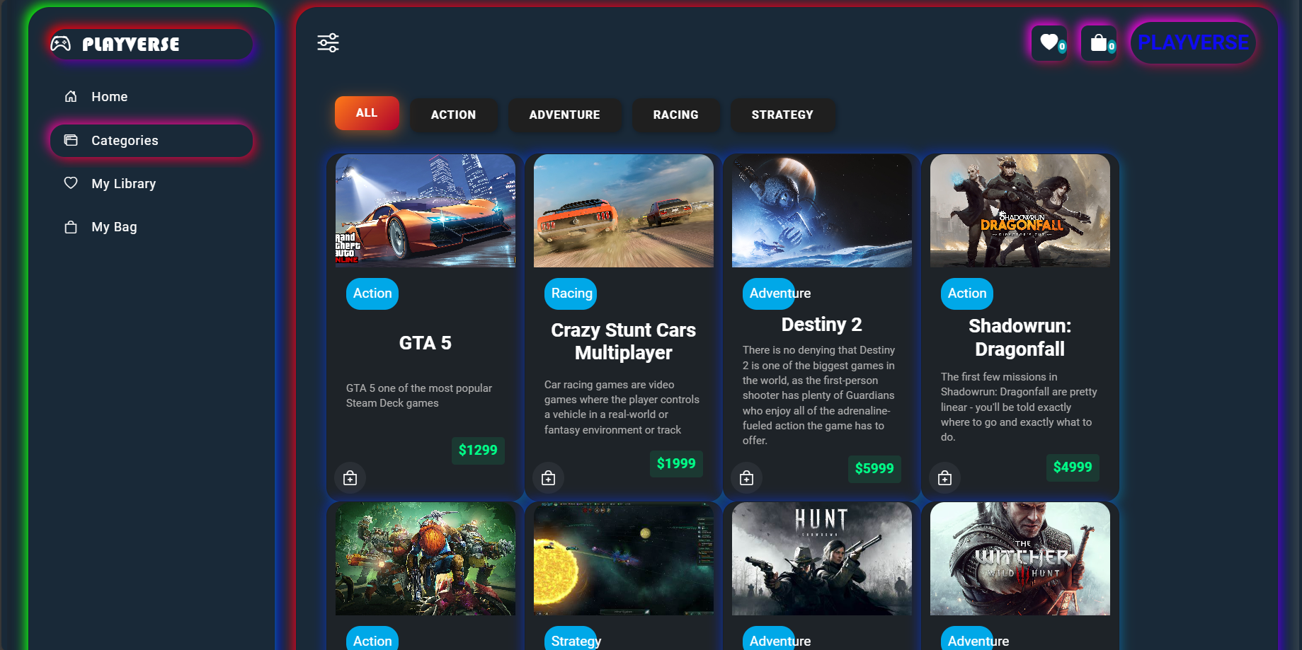

Slide 11
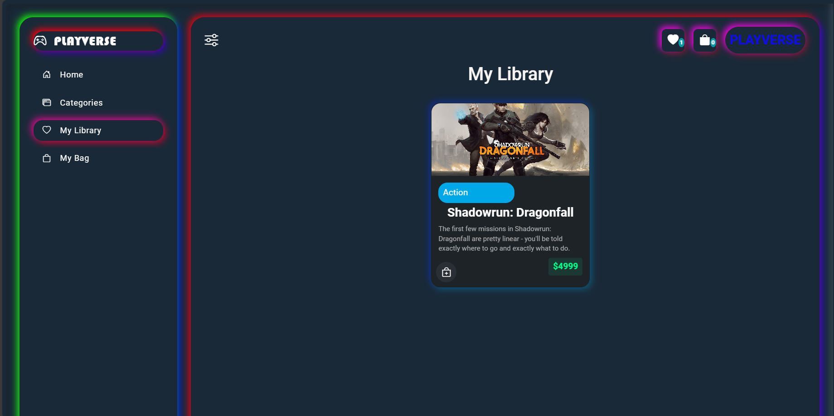

Slide 12
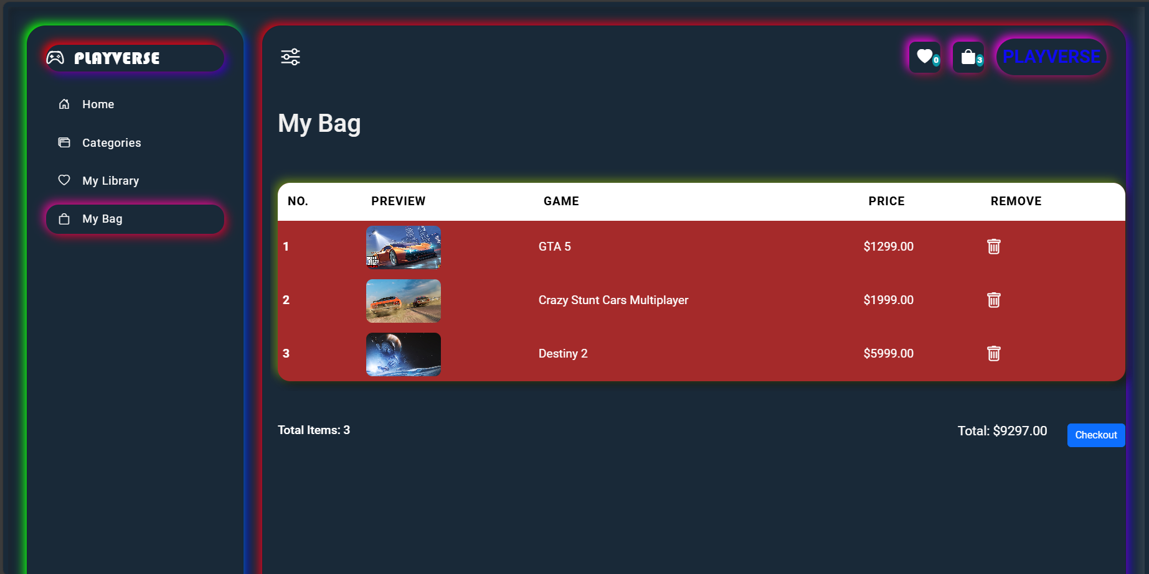

Slide 13
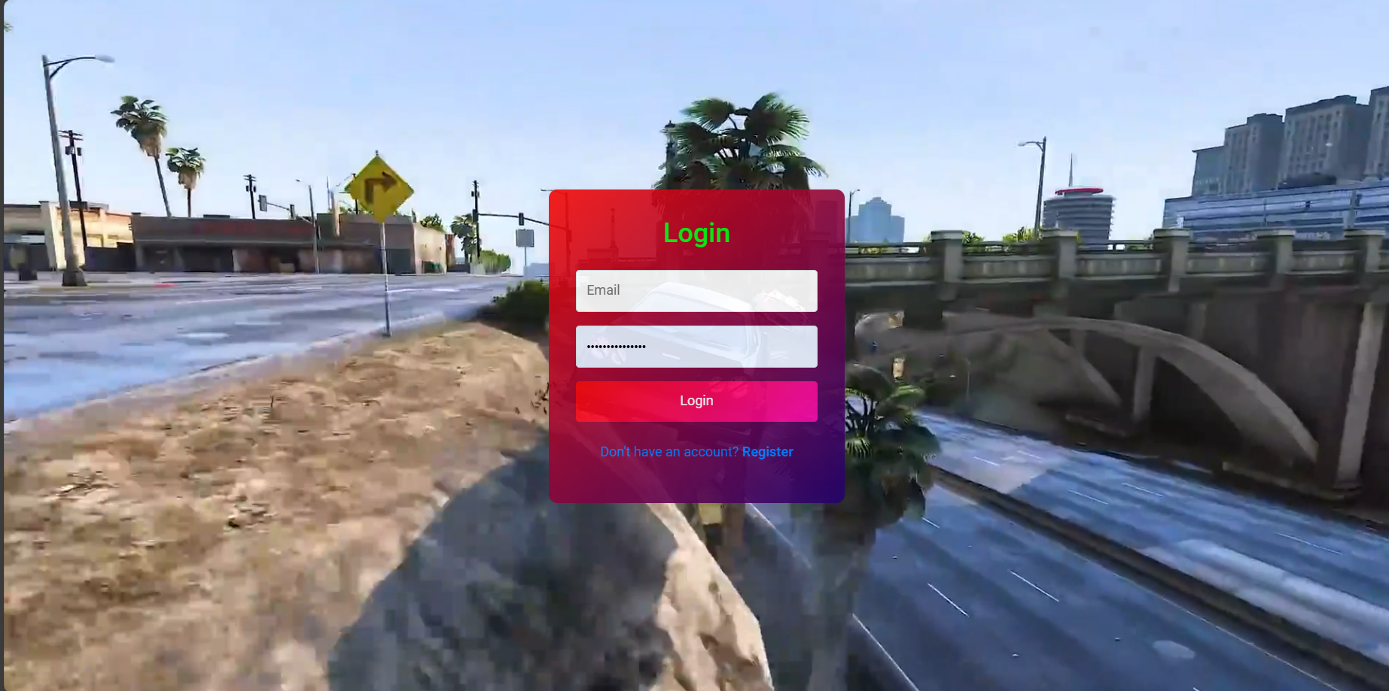

Slide 14
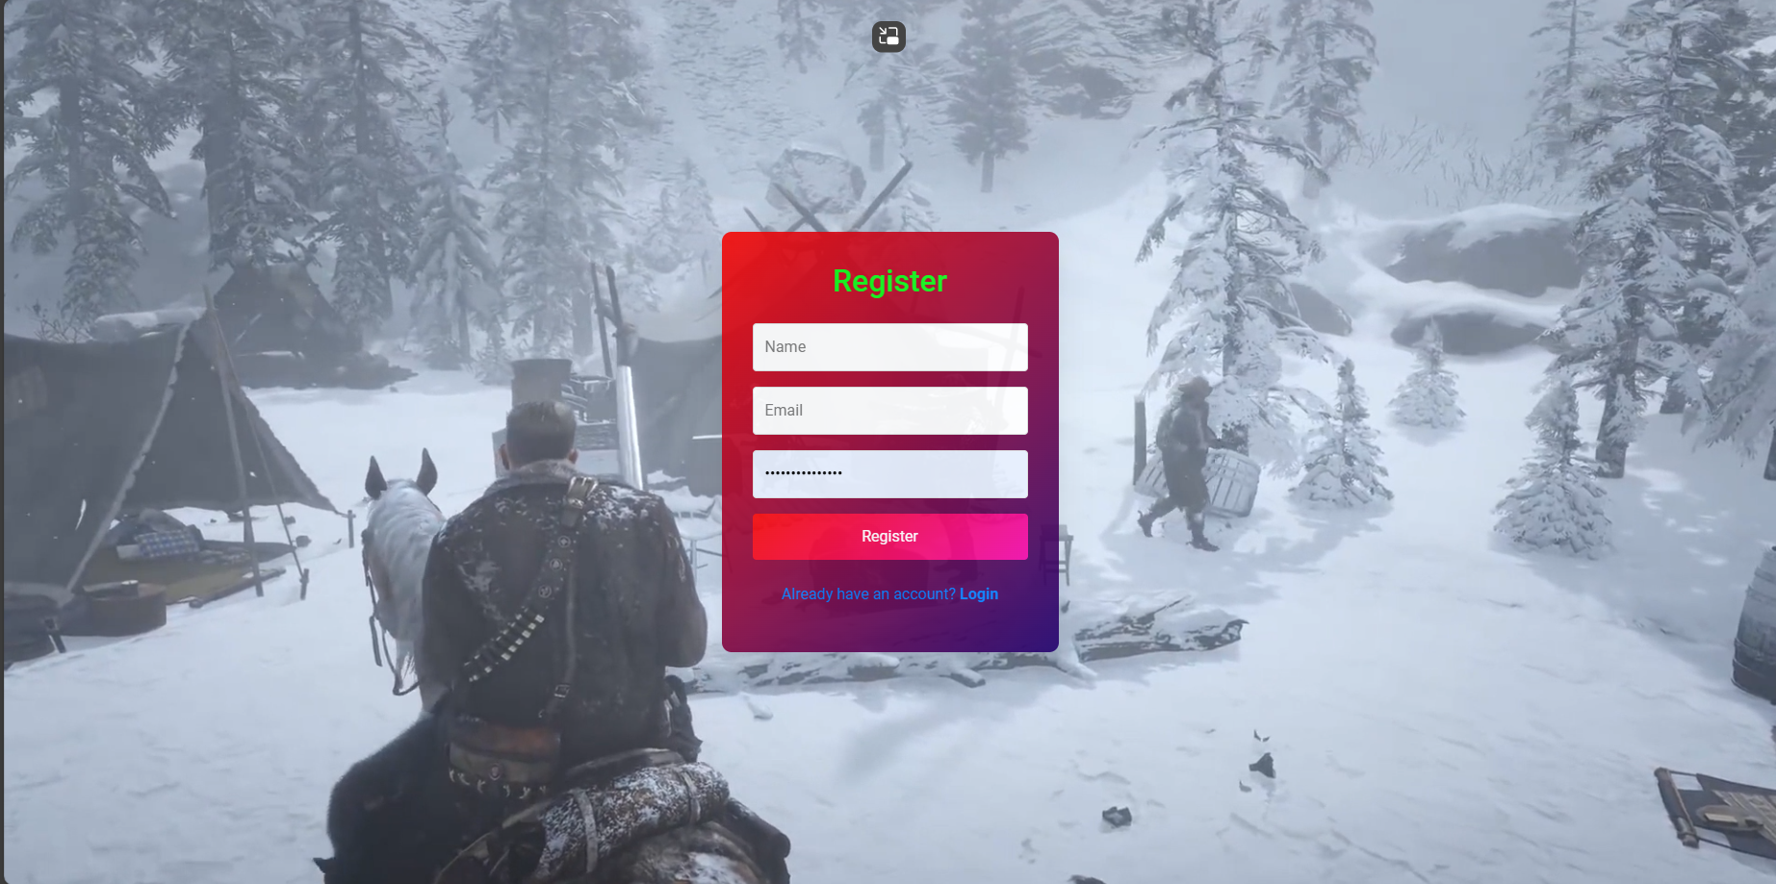

Slide 15
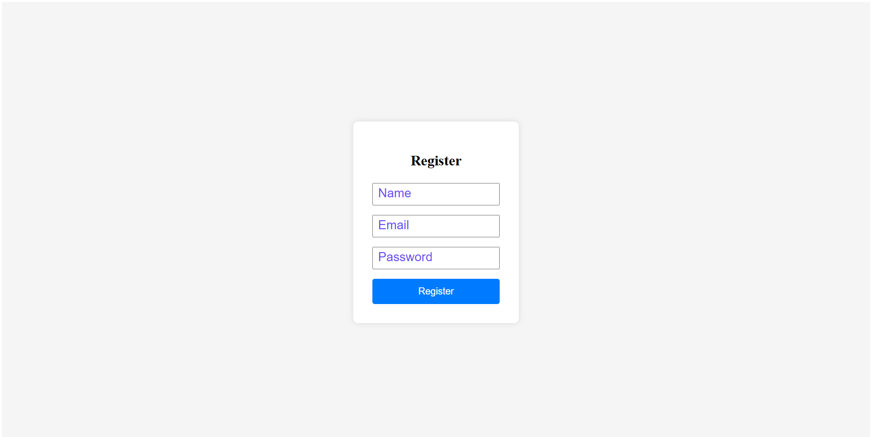

Slide 16
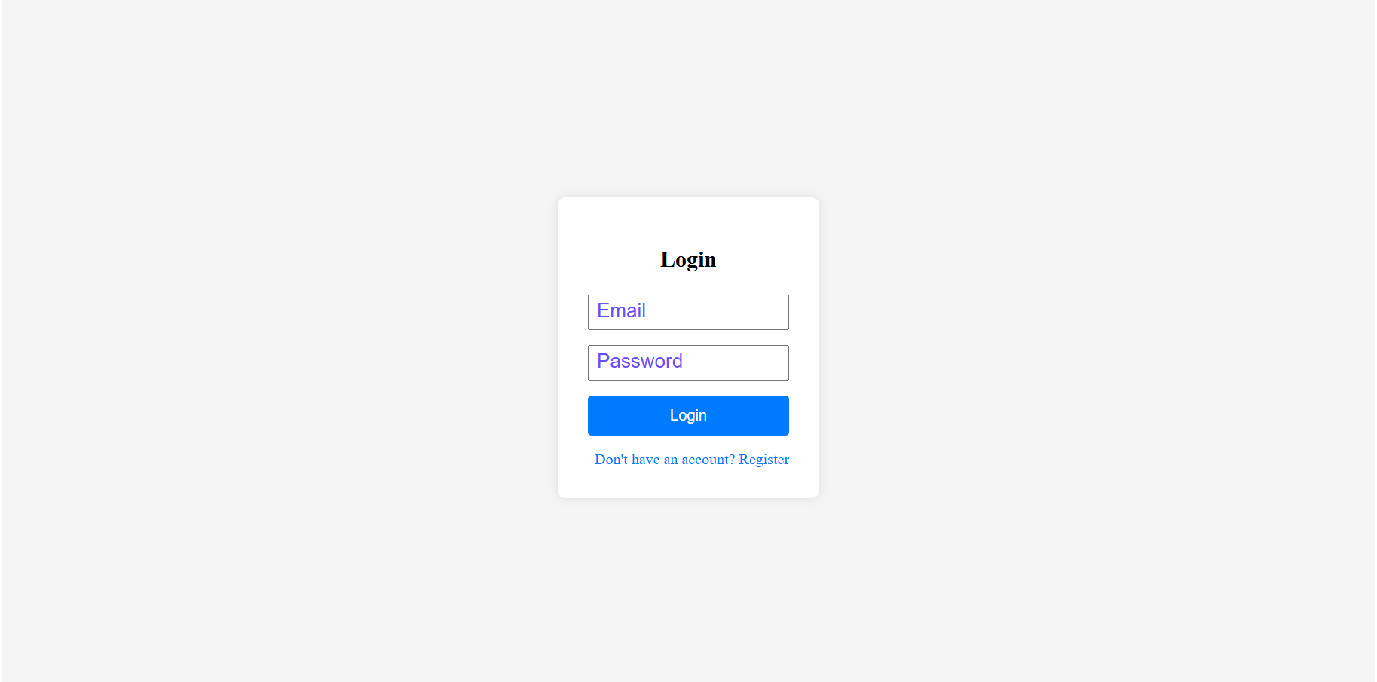

Slide 17
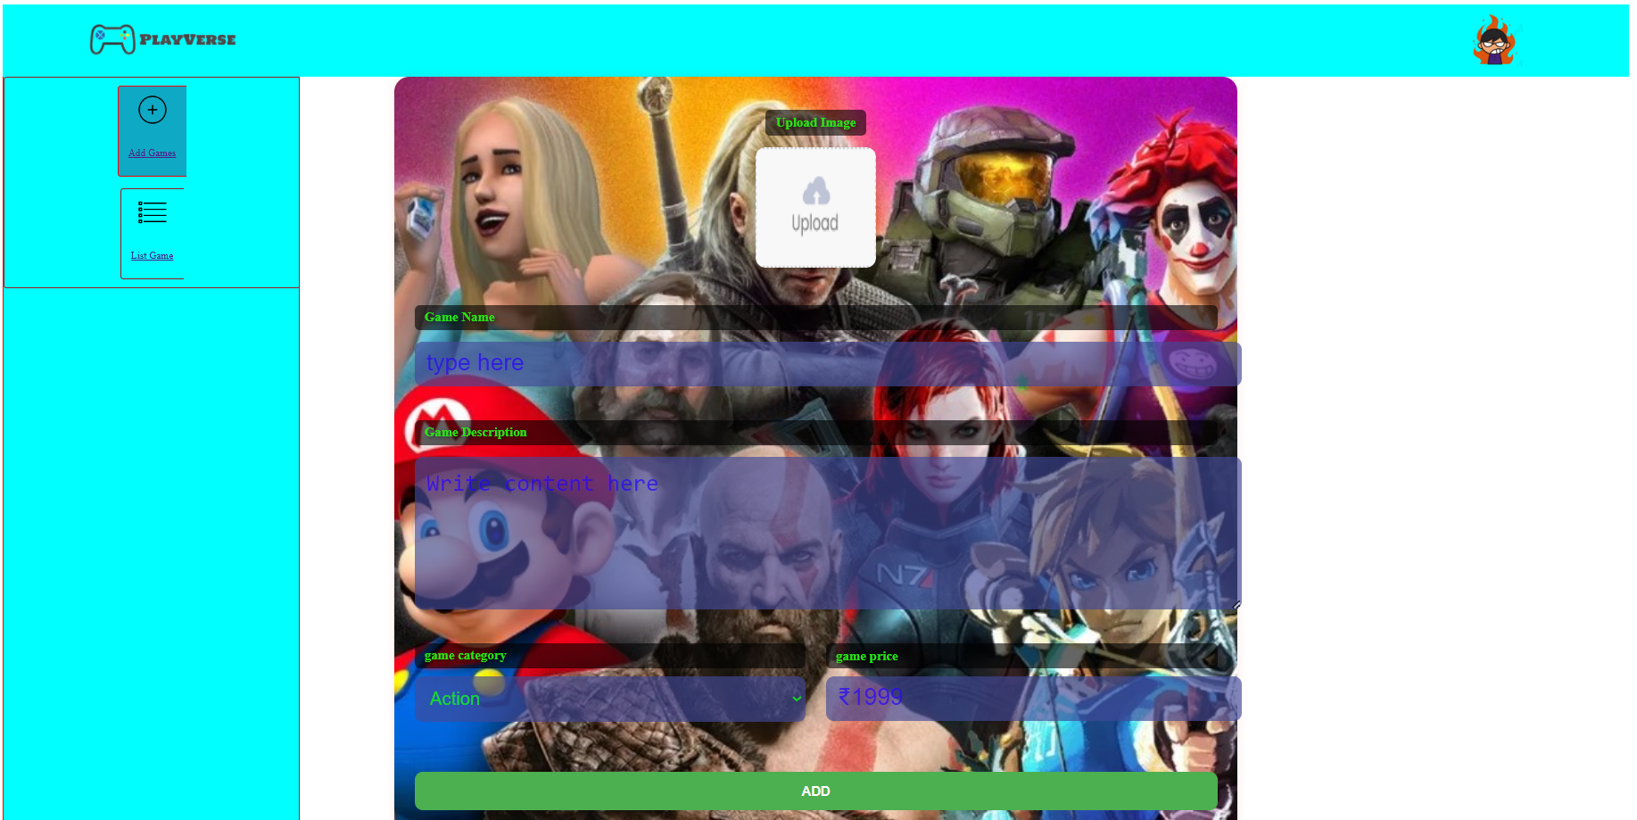

Slide 18
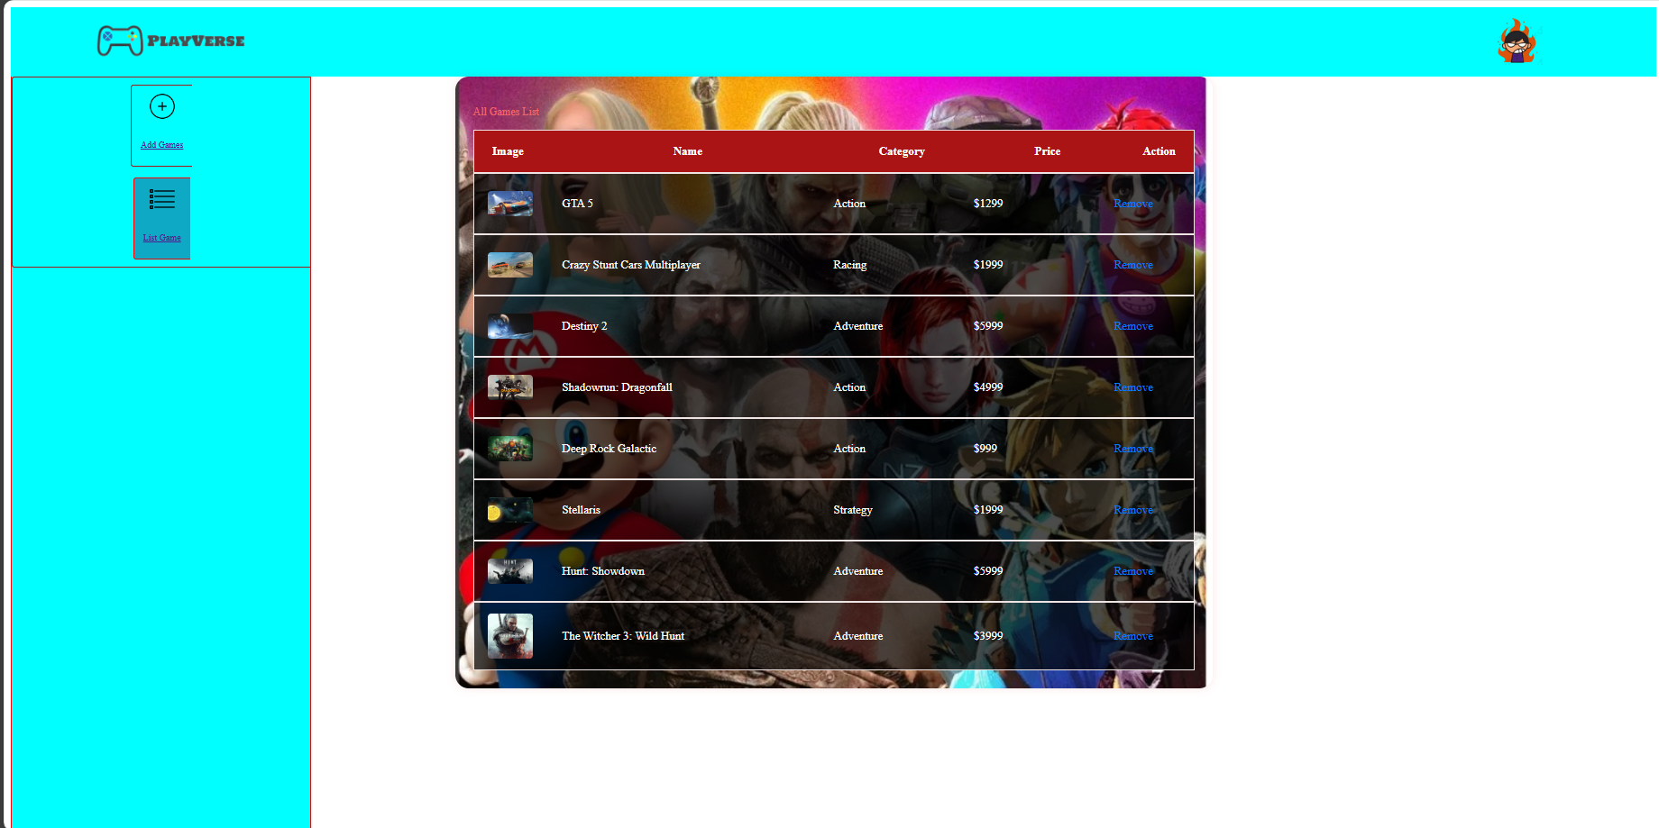

Slide 19
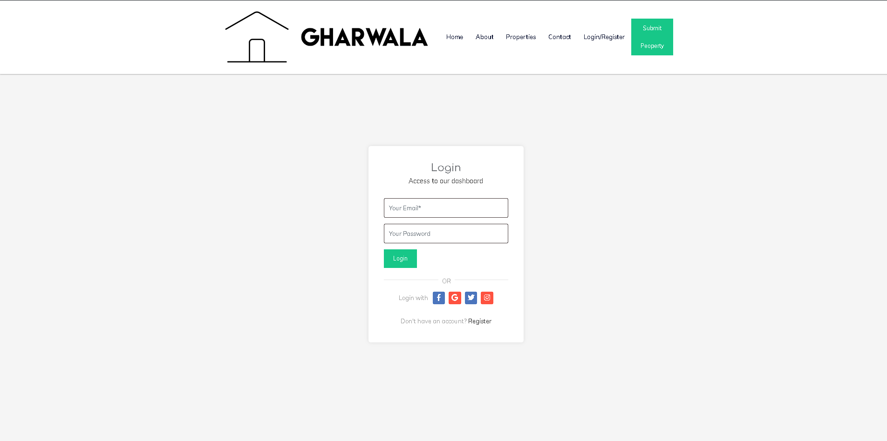
Product Modules
LOGIN PANEL PAGE
Accessible form prompts for a username/email and password, designed for ease of use and quick access.
Displaying error messages clearly but discreetly ensures users are informed of incorrect credentials without compromising security or user experience.
To Access the Dashboard.
Enter Email Address
Enter Password

Slide 20
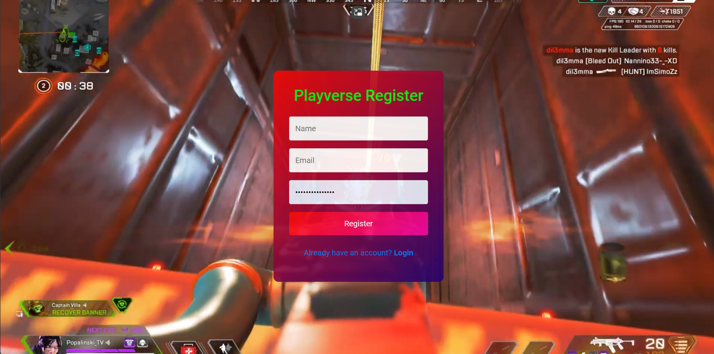
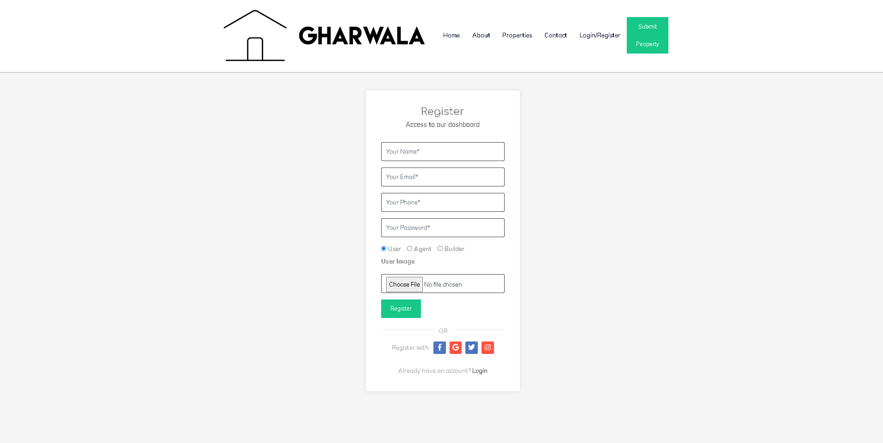
REGISTRATION PANEL PAGE
A collects essential user details (name, email, password) and includes a captcha verification to deter automated bot registrations.
User Name
User Email
User new password

Slide 21
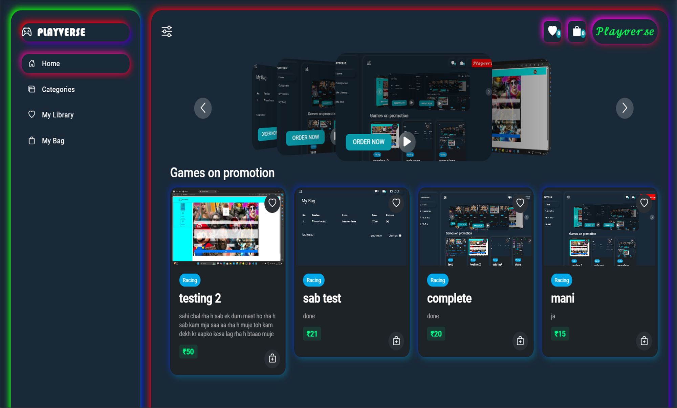
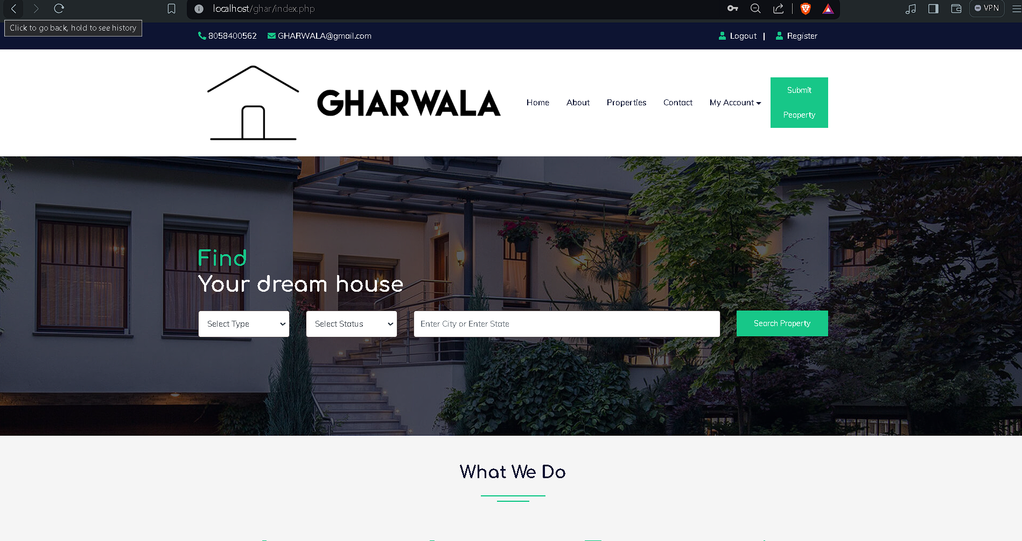
USER/HOME PANEL PAGE
The Playverse Home Page offers a visually engaging layout with a hero banner showcasing popular games, a streamlined navigation bar, and a game catalog.
Features include personalized recommendations, a search and filter bar, and game promotions. Clear CTAs guide users, while a footer provides essential links and support information.

Slide 22
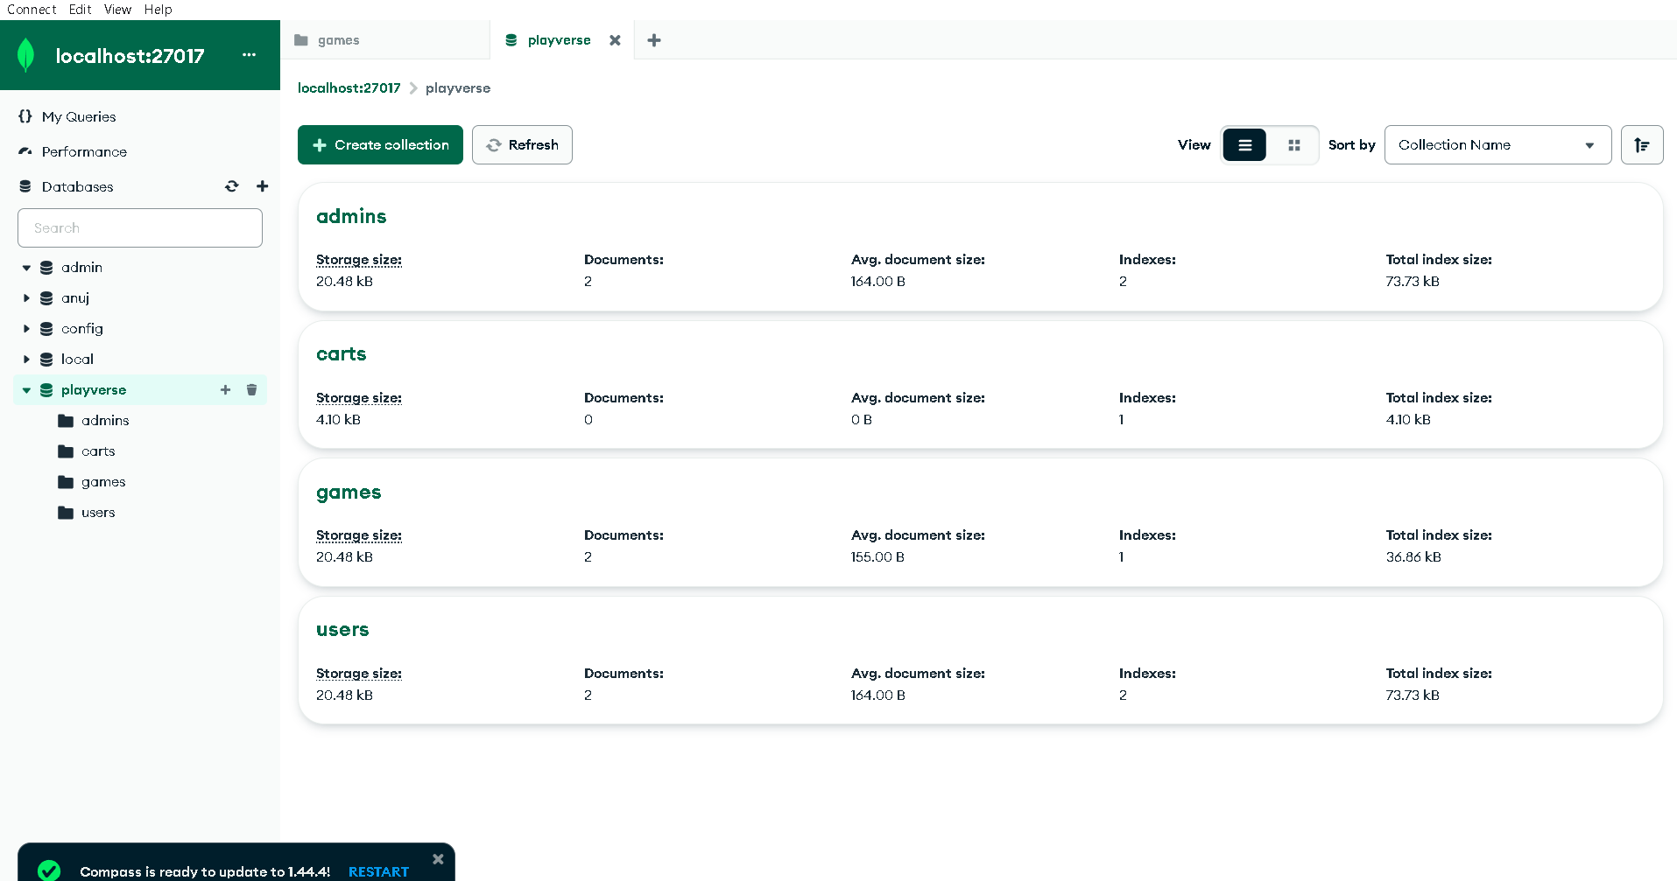
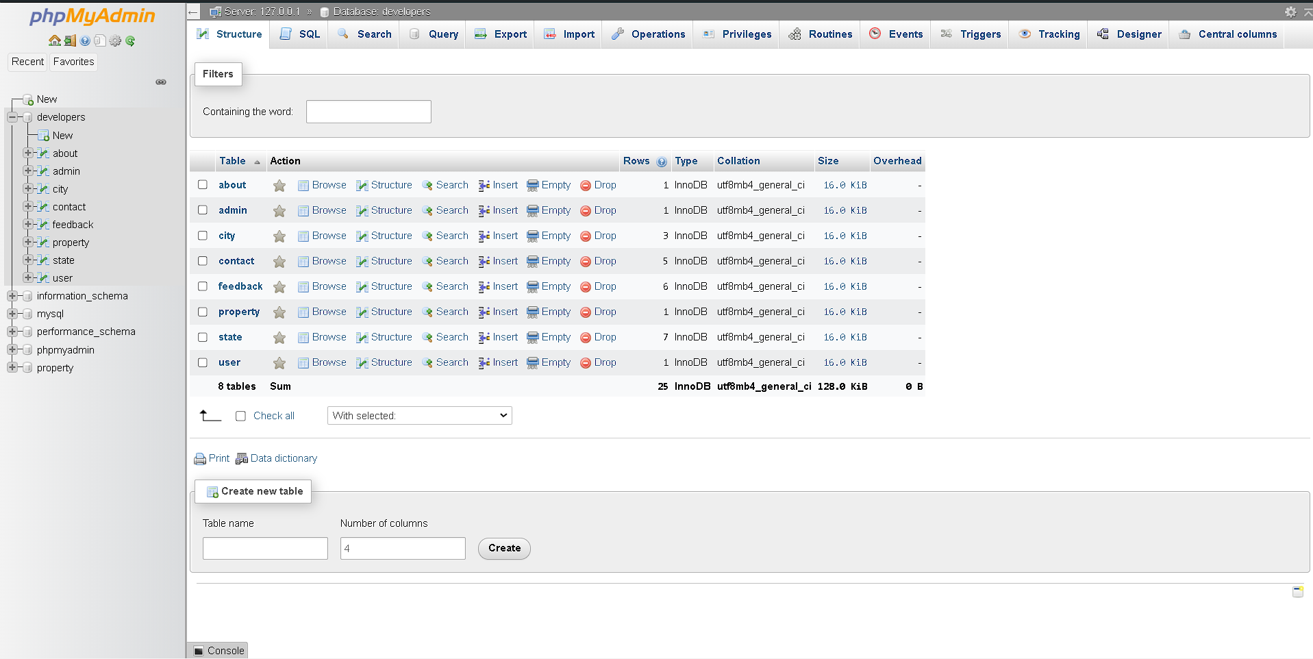
DATABASE TABLE PAGE
This DATABASE table stores essential information about users that they provide during their usage of the “PLAYVERSE" website, facilitating user management, authentication, and personalized services.

Slide 23
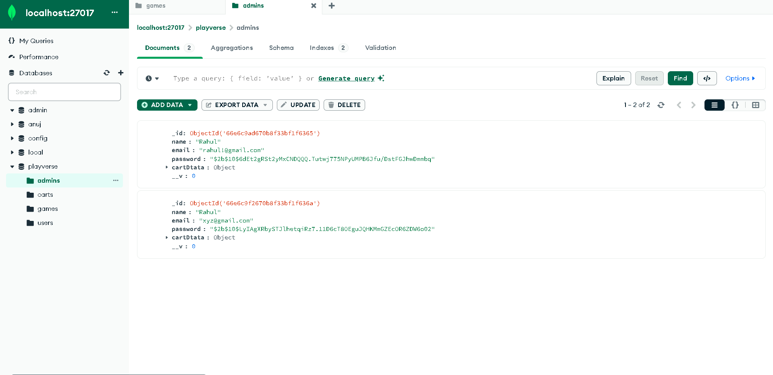
ADMIN Table PAGE
This ADMIN table Stores the information about users that they used to log into the account on “PLAYVERSE" website. i.e Name, email, password.

Slide 24
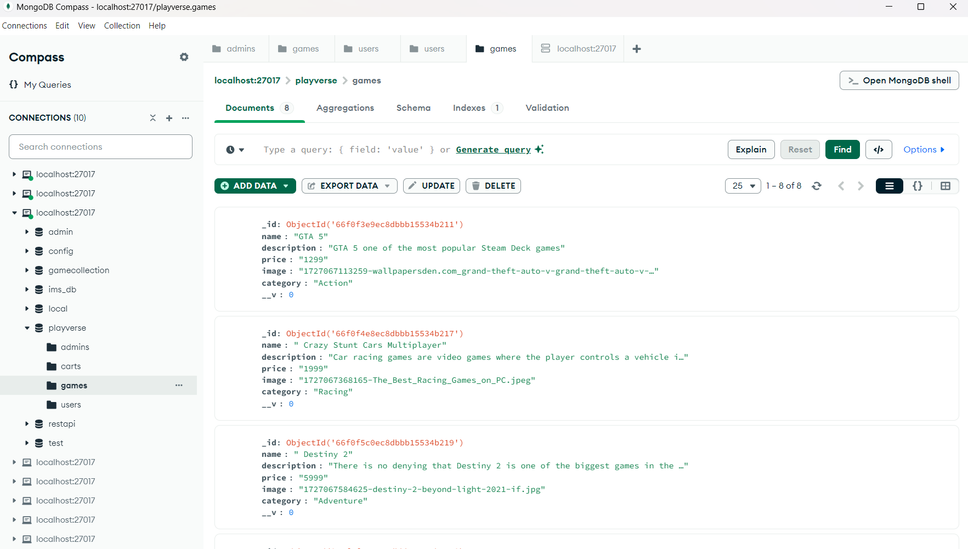
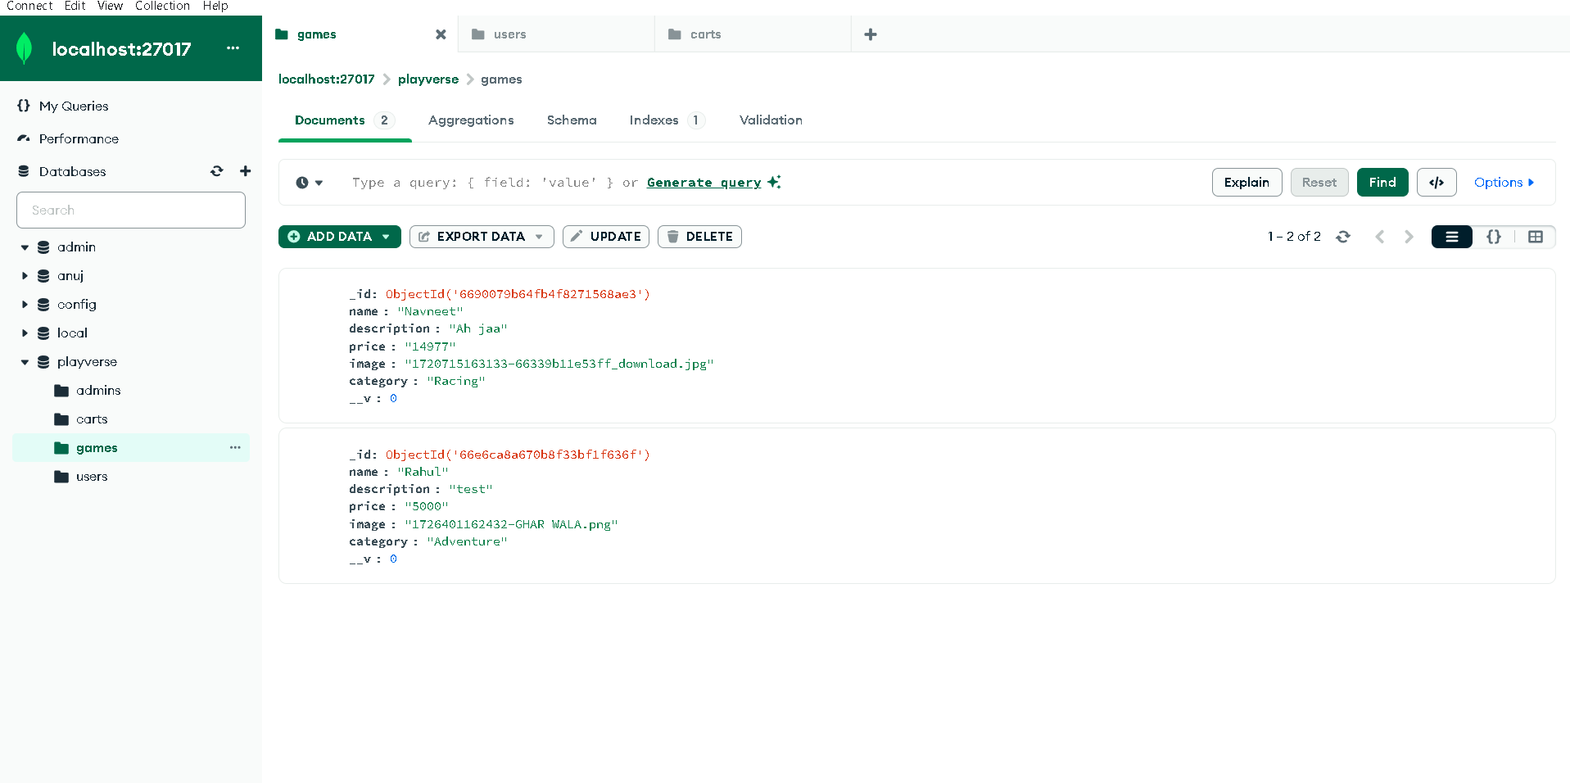
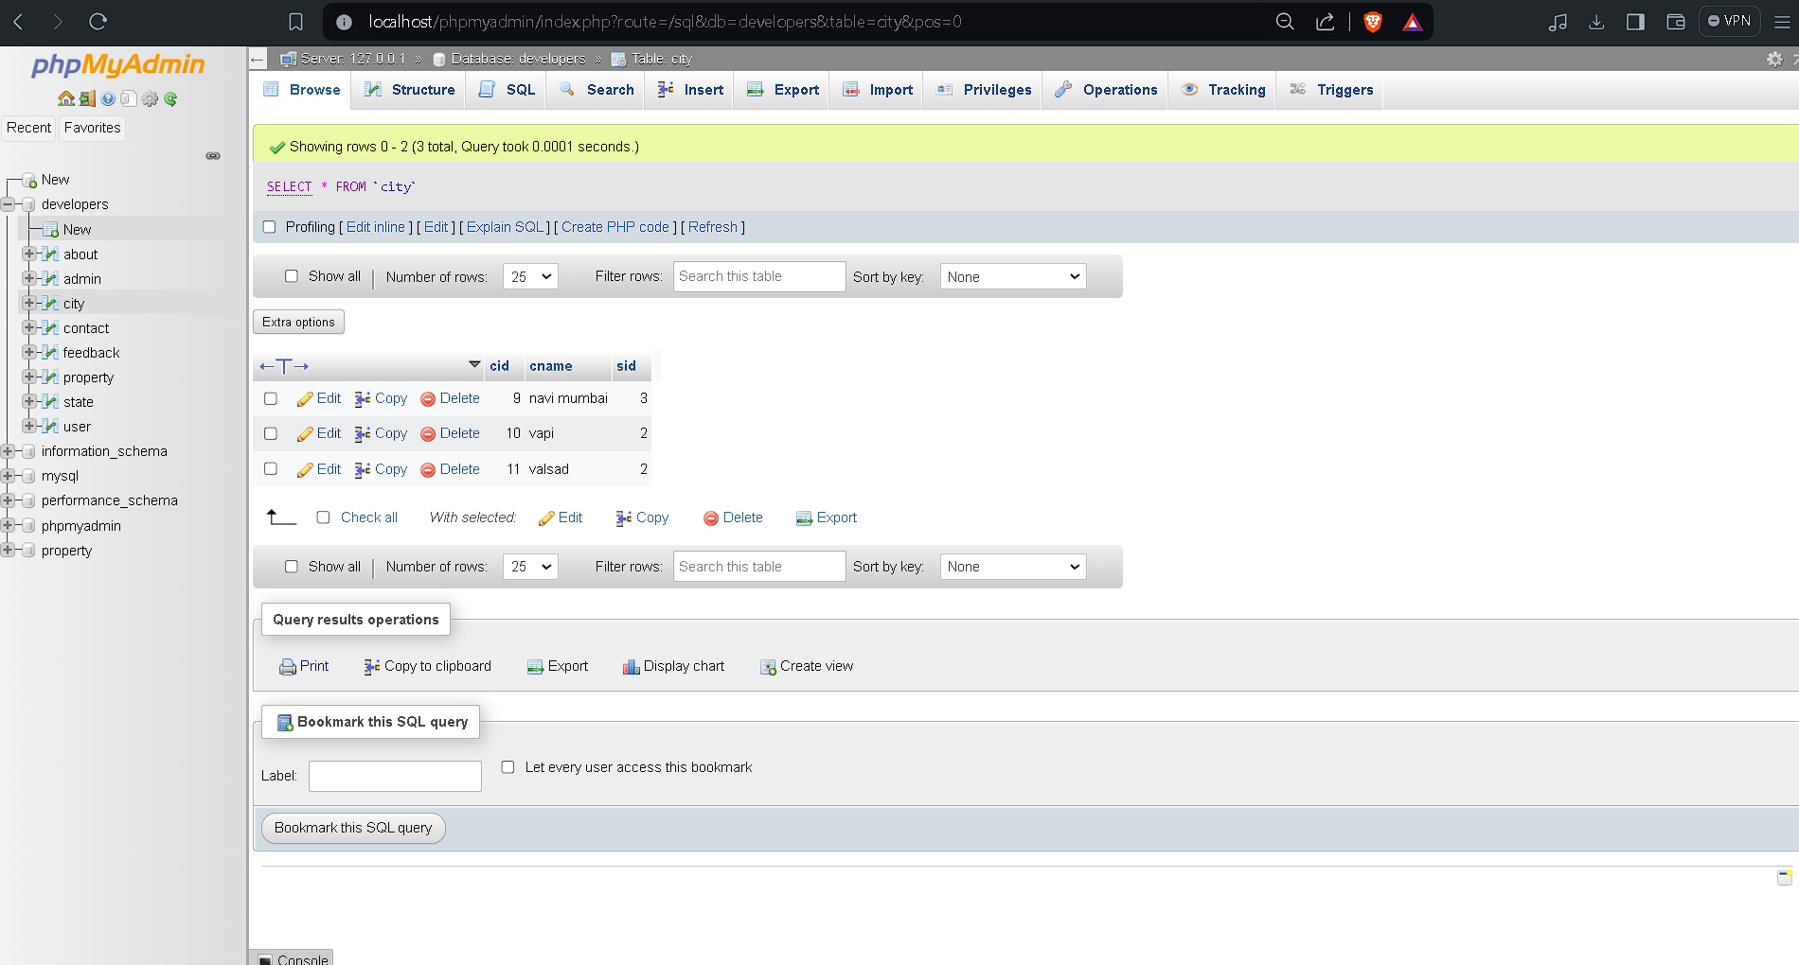
GAMES TABLE PAGE
The Games table Stores the information about the Available Games that are shown on “PLAYVERSE" website while searching for your Dream Game.

Slide 25
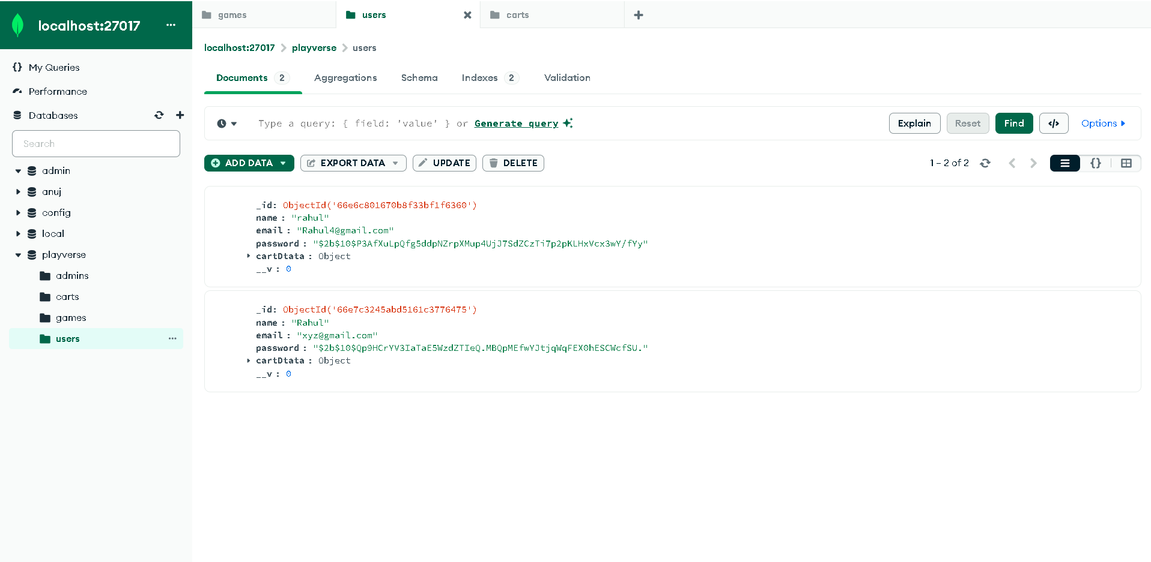
USER TABLE PAGE
Here's a concise description of a user table:
User Table:Stores user details including `user_id`, `username`, `email`, `password_hash`, `first_name`, `Supports authentication, profile management, and role differentiation.

Slide 26


